Slide 1







FANVERSE
Community Application
Where your fandom comes alive.
A microservices-based platform where fans connect, discover communities, share their passion, and interact with others.
Connect • Discover • Share
TEAM MEMBERS
Nandan Kamaraddi
Neha Nayak
Vajapeyayajula Sreelasya
Vaishnavi Shetti

Slide 2








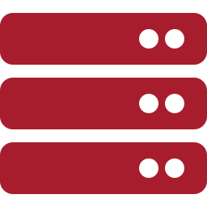

Presentation Contents
01
Project Introduction
06
DevOps and AWS Deployment
02
Problem Statement and Solution
07
General System Flow
03
Technology Stack
08
Role-Based Workflows
04
Frontend Architecture
09
Non-Functional Requirements (NFRs)
05
Backend Microservices Architecture
10
Challenges and Learnings

Slide 3








Introduction, Problem Statement and Solution
INTRODUCTION
FANVERSE is a web application that brings fans together to discover communities, share posts, comment, react, and receive notifications.
PROBLEM STATEMENT
Scattered Fan Communities
PROPOSED SOLUTION
One FANVERSE Platform
Fan content is scattered across different platforms.
Provide one platform for fan communities and discussions.
Finding and managing fan communities can be difficult.
Let users join channels, share posts, comment, and react.
Content moderation and secure user access are important.
Support role-based access and content moderation.
The platform should remain reliable as usage grows.
Connects fans and creators and provides a dedicated space for them to interact

Slide 4
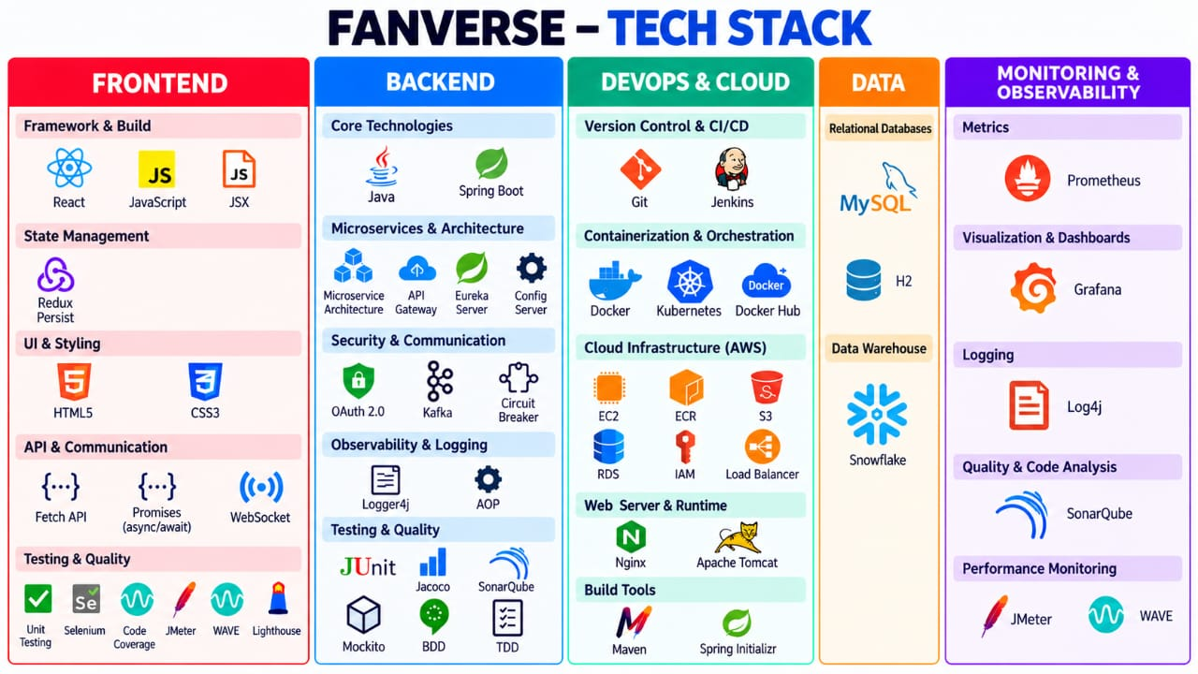
FANVERSE Technology Stack

Slide 5
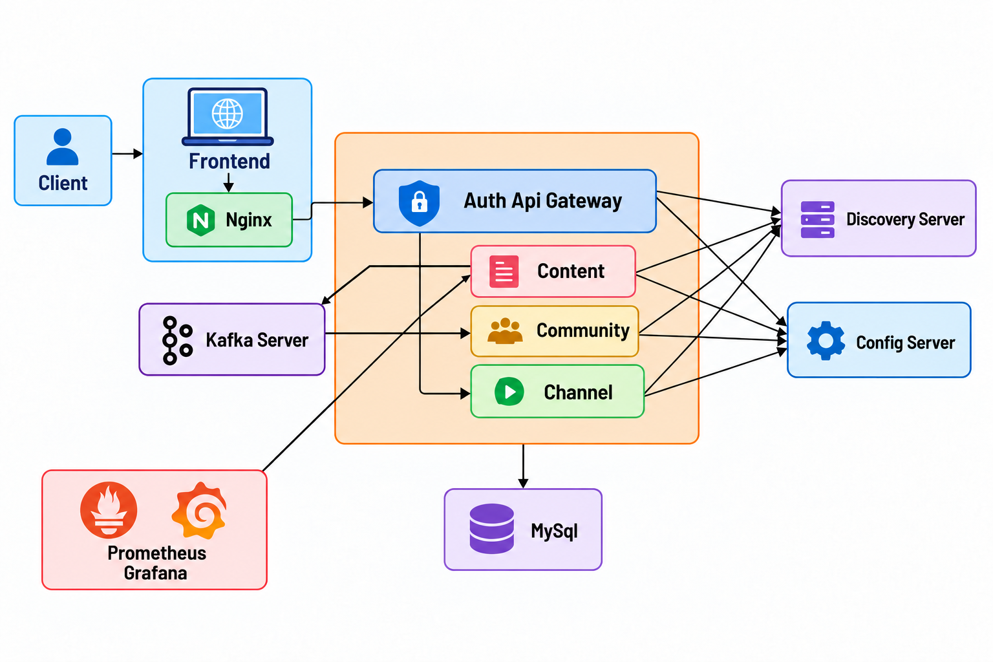
General System Flow Diagram

Slide 6
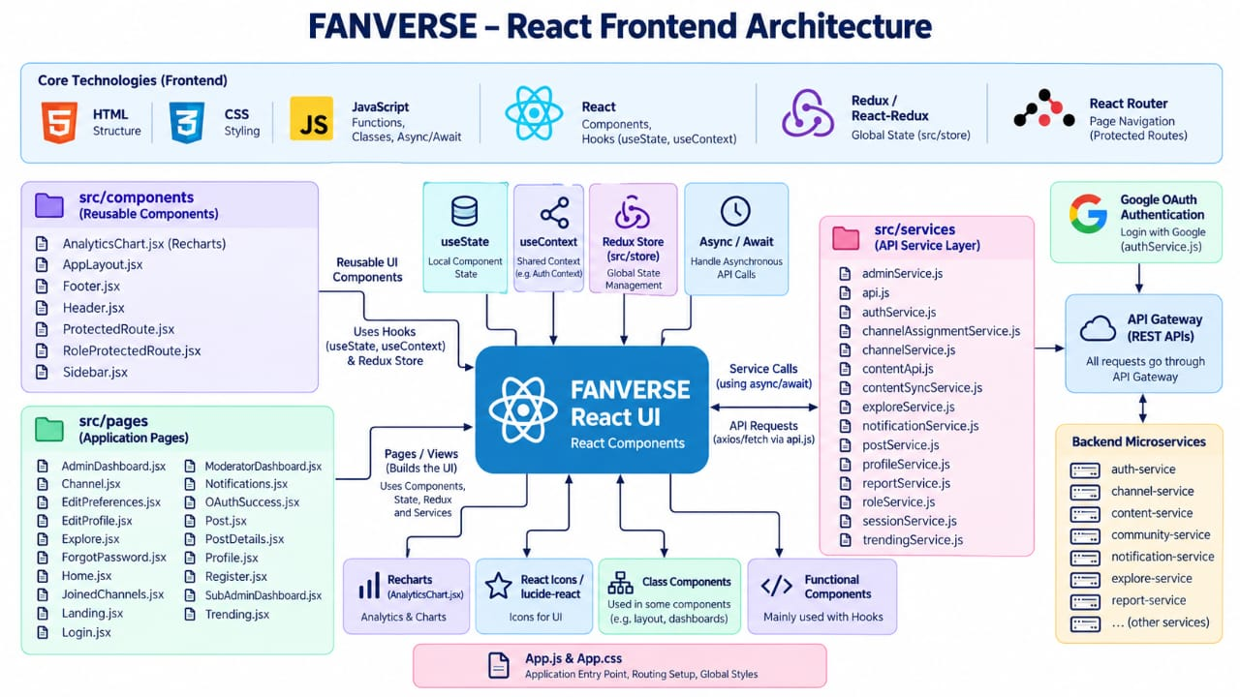
Frontend Architecture
Insert frontend architecture diagram here
Recommended: 16:9 image. Resize this frame to match your diagram.

Slide 7
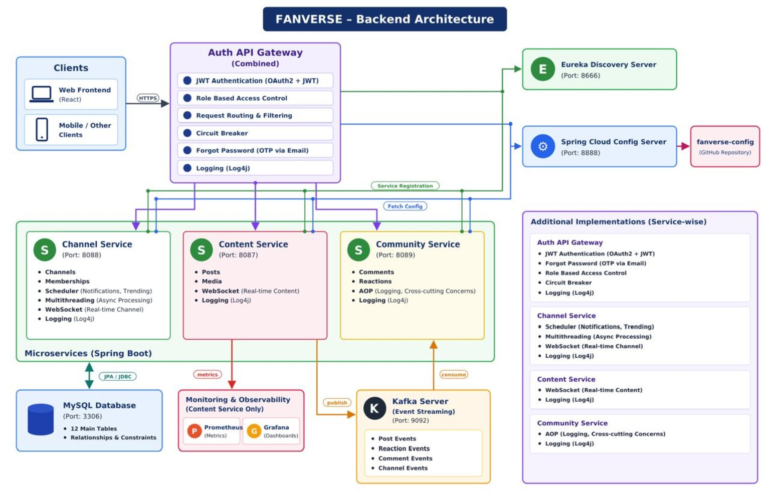
Backend Microservices Architecture

Slide 8
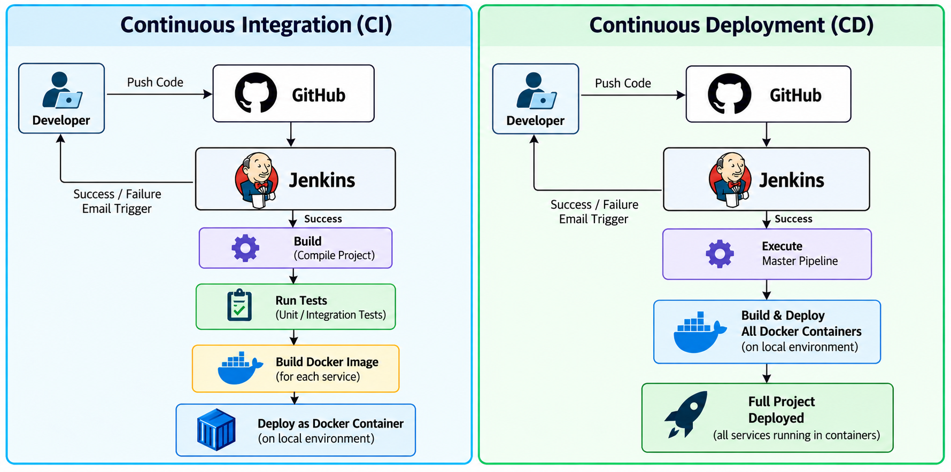
DevOps and CI/CD Architecture

Slide 9
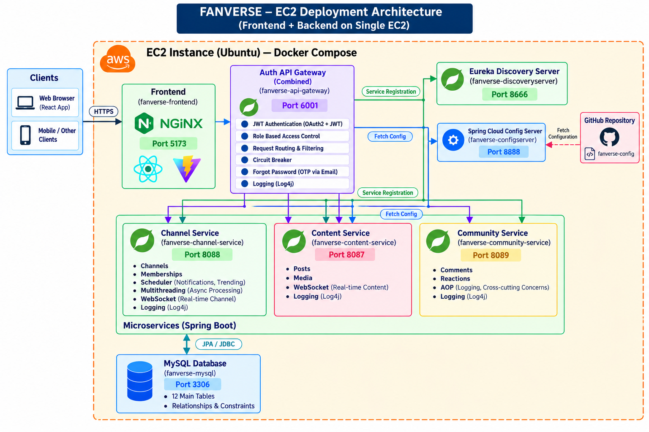
AWS EC2 Deployment Architecture

Slide 10
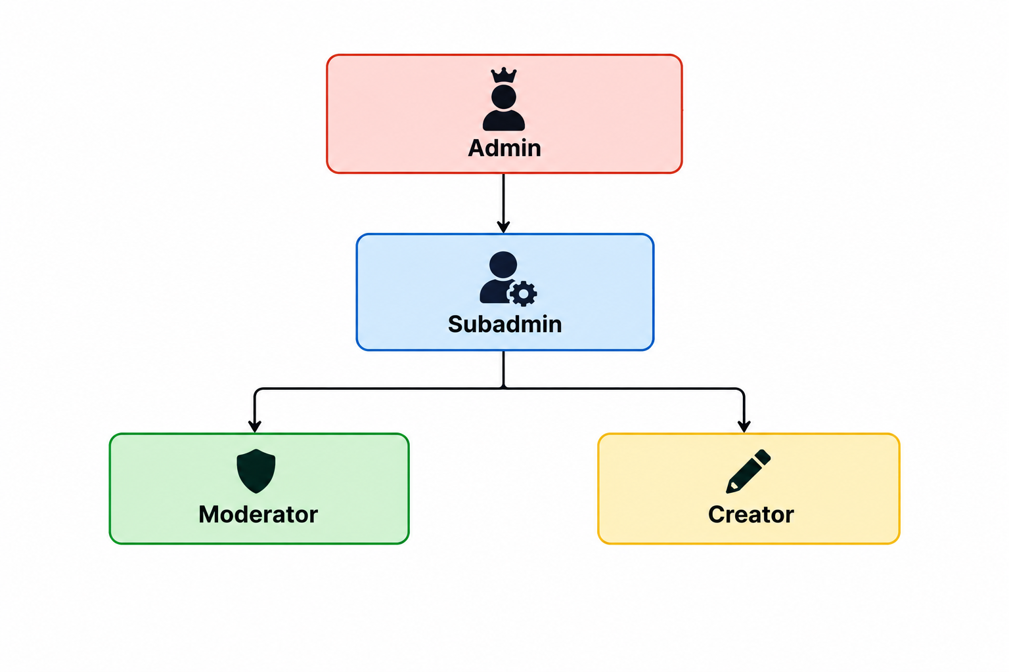
Roles

Slide 11
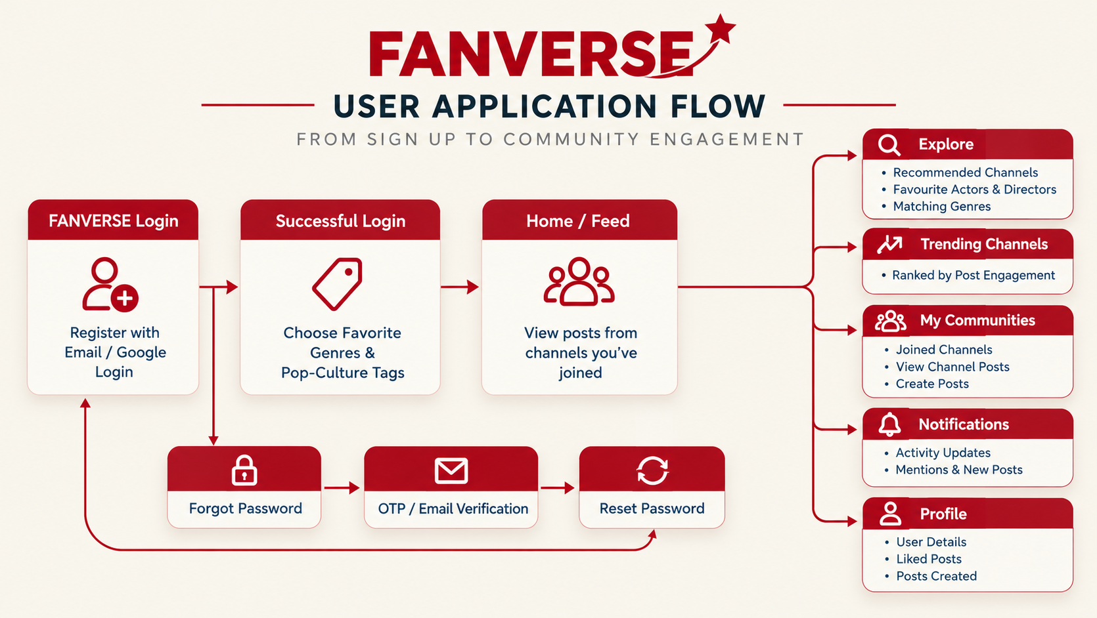
User Workflow

Slide 12
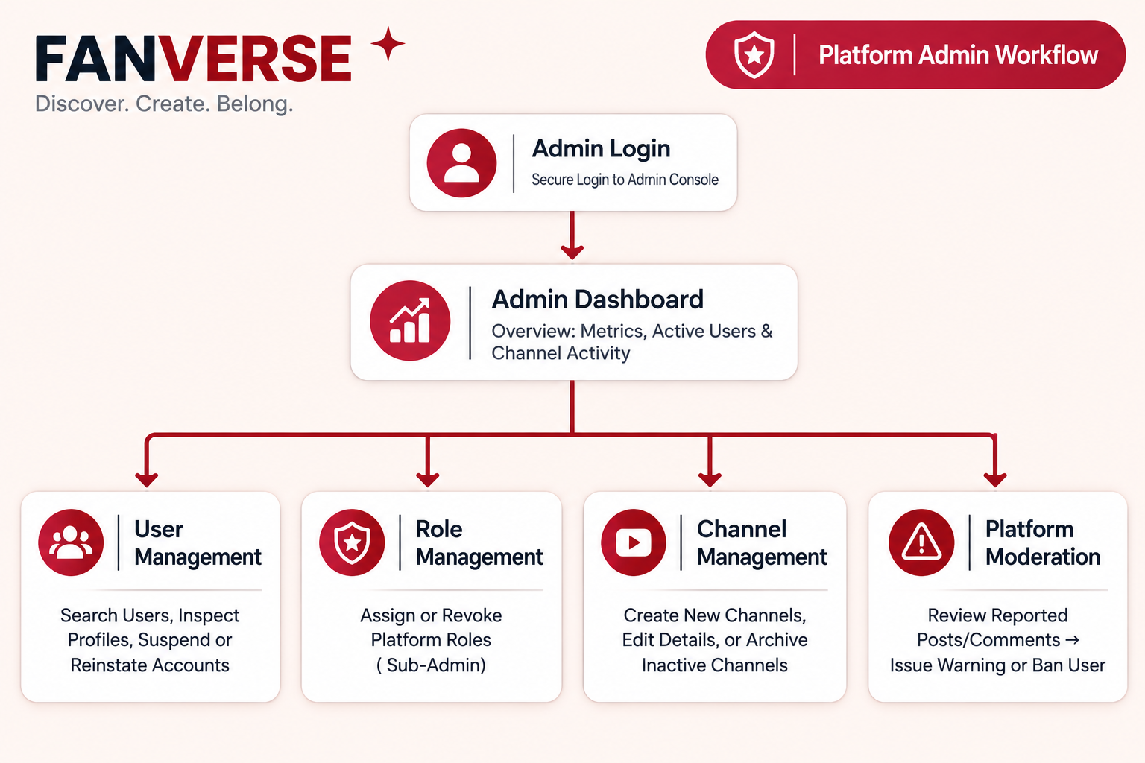
Admin Workflow
Insert admin workflow diagram here
Recommended: 16:9 image. Resize this frame to match your diagram.

Slide 13
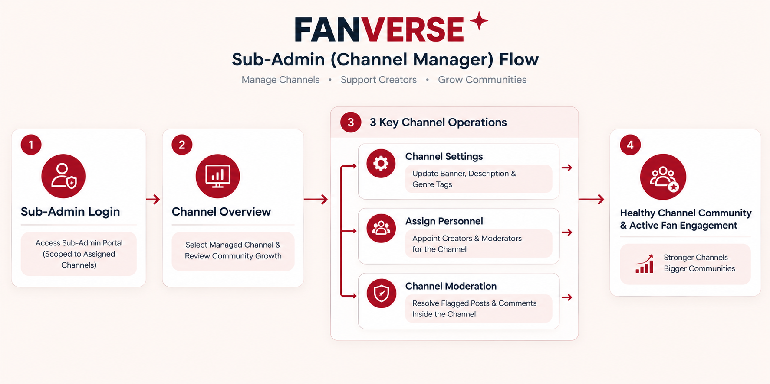
Sub-Admin Workflow

Slide 14
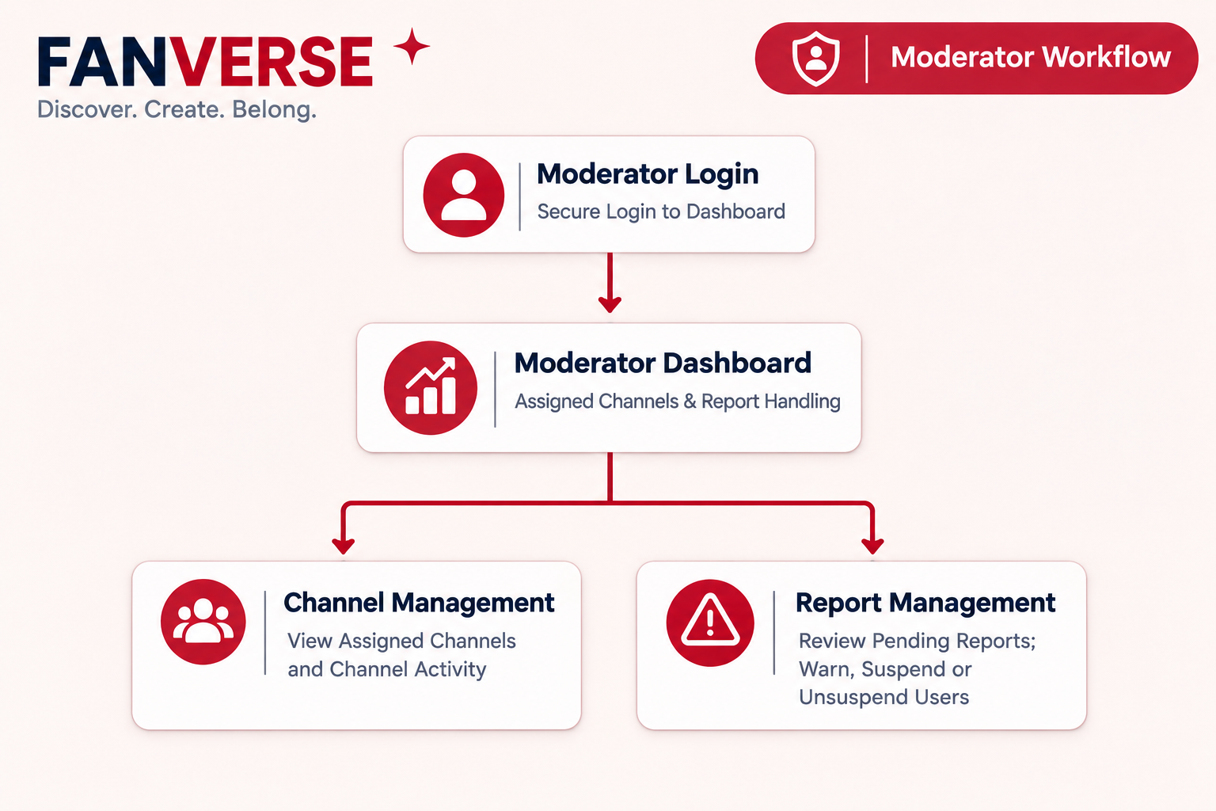
Moderator Workflow

Slide 15
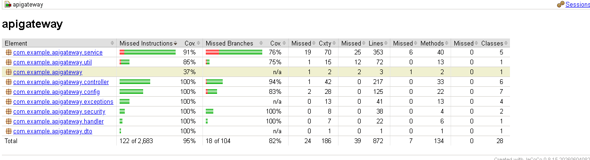
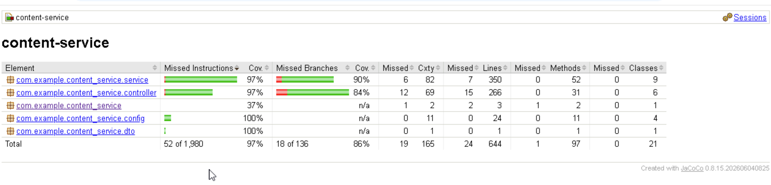
Non-Functional Requirements and Testing Reports
Jacoco code coverage reports

Slide 16
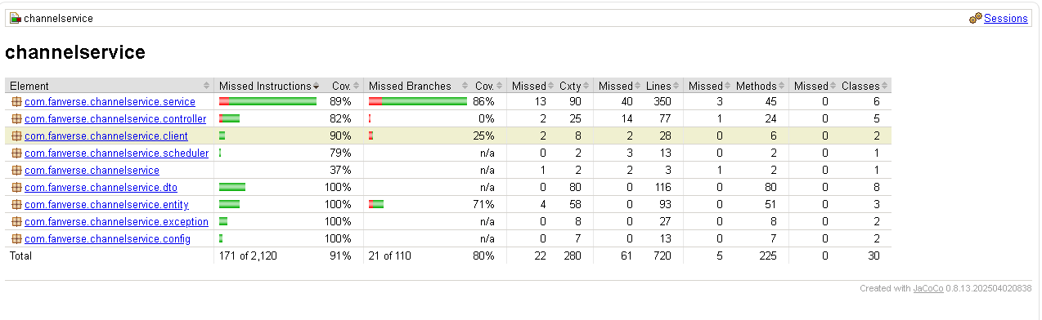
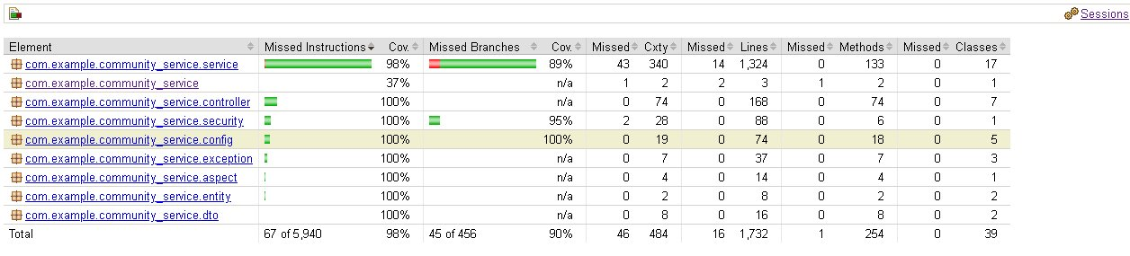
Jacoco code coverage reports​
Community-service

Slide 17
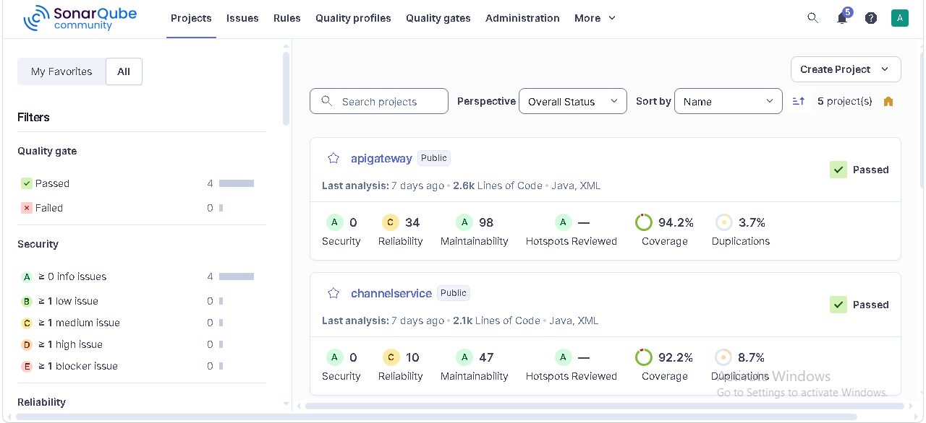
SonarQube Reports

Slide 18
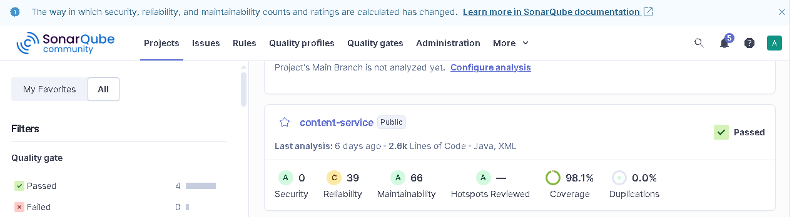
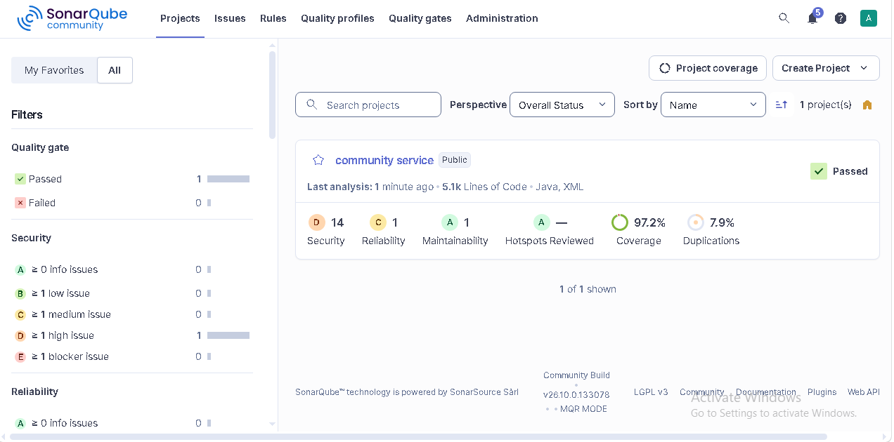
SonarQube Reports​

Slide 19
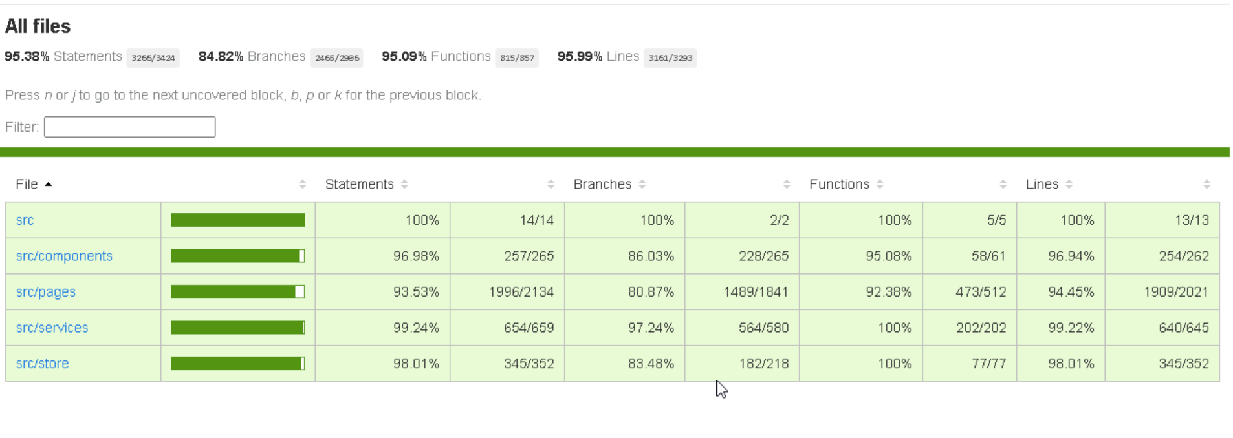
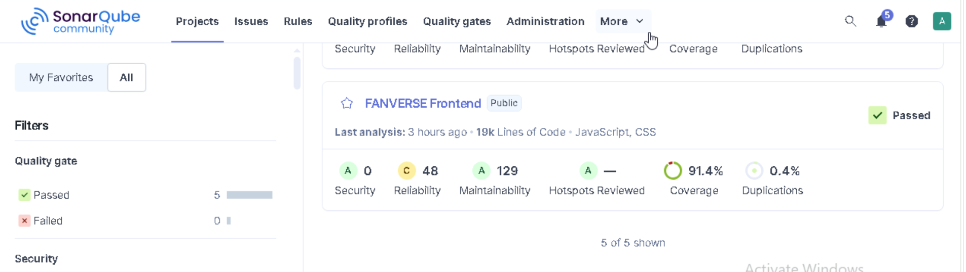
SonarQube Reports​

Slide 20
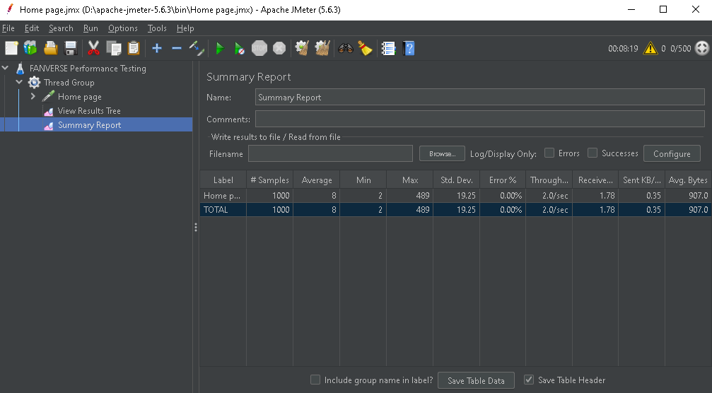
JMeter Report

Slide 21
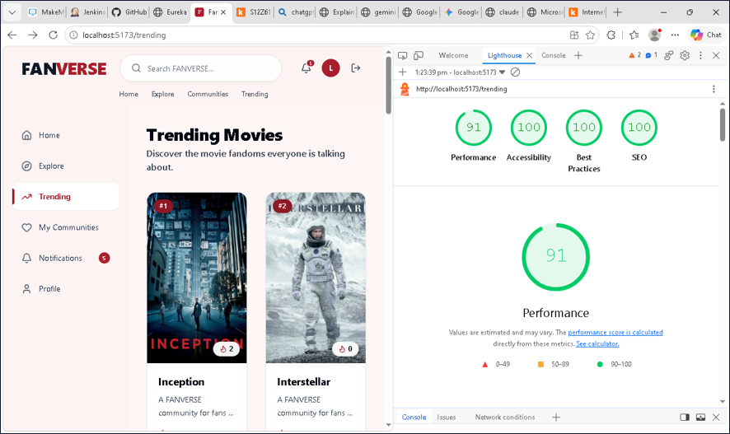
LightHouse Report

Slide 22
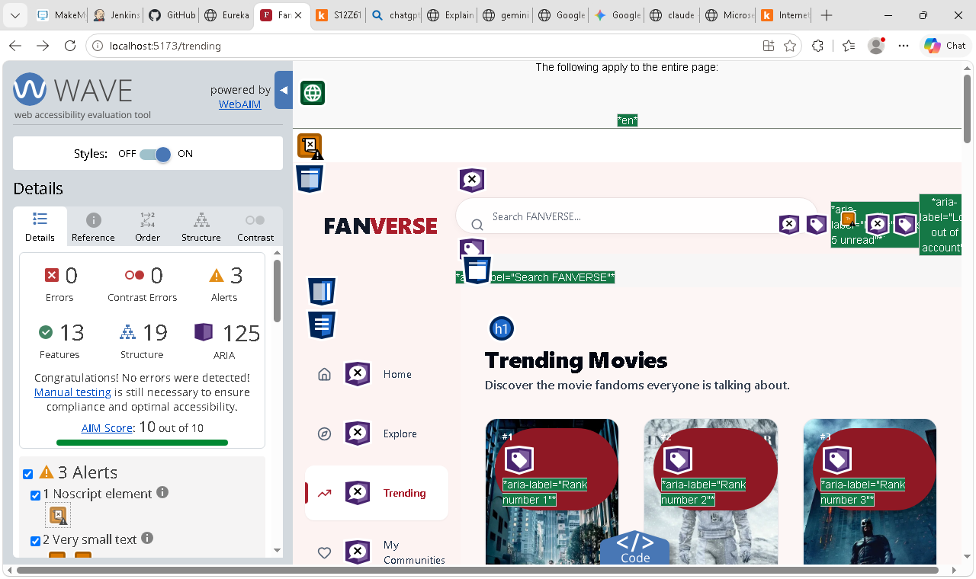
Wave Report

Slide 23
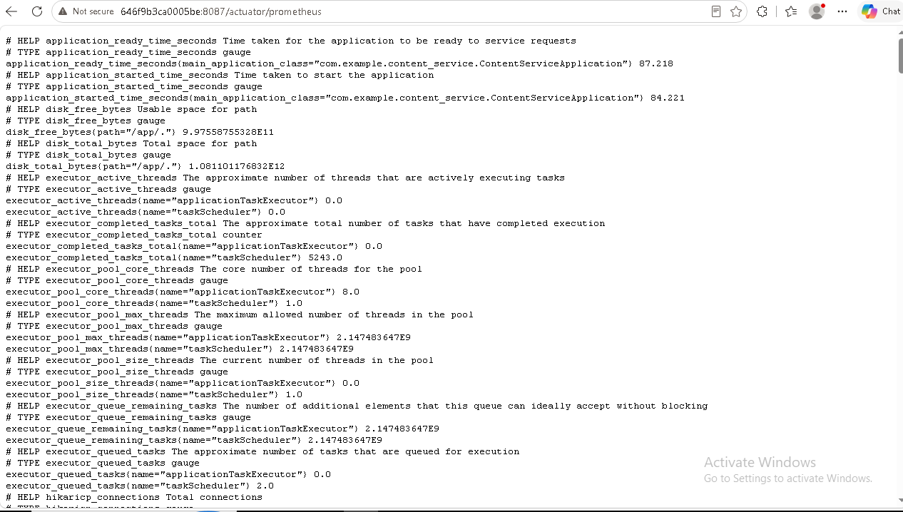
Prometheus Monitoring​

Slide 24
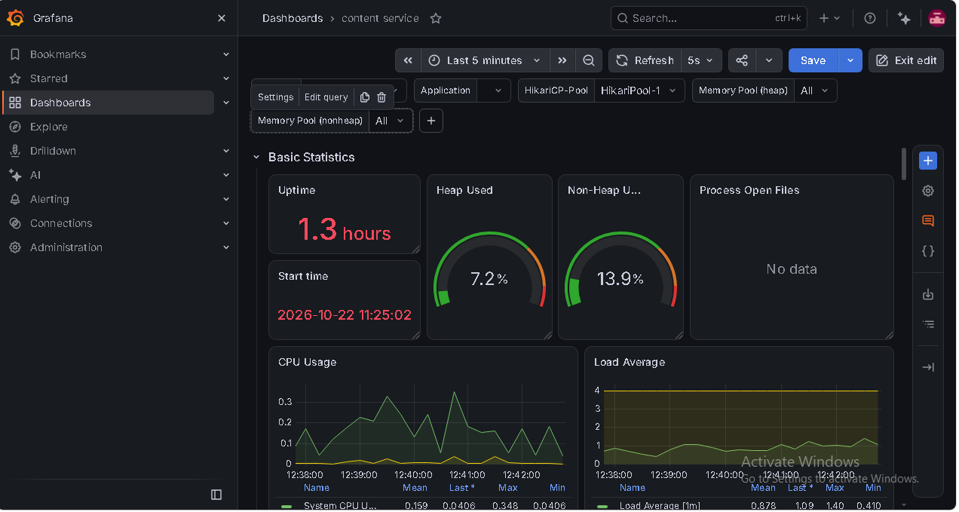
Grafana Monitoring

Slide 25
Challenges and Learnings
Challenges Faced
Limited AWS IAM permissions restricted access to services like RDS and ECR.
Configuring a master Jenkins pipeline for automated deployment to EC2.
Troubleshooting Docker networking, port conflicts, and service startup dependencies.
Resolving CORS errors in local and Docker environments.
Key Learnings
Designing and integrating a modular microservices architecture using Spring Boot and Eureka.
Implementing JWT authentication, OAuth concepts, and role-based access control.
Containerizing microservices using Docker and orchestrating them with Docker Compose.
Automating build and deployment workflows using Jenkins CI/CD and deploying on AWS EC2.

Slide 26
Q & A

Slide 27
Thank You

